Slide 1
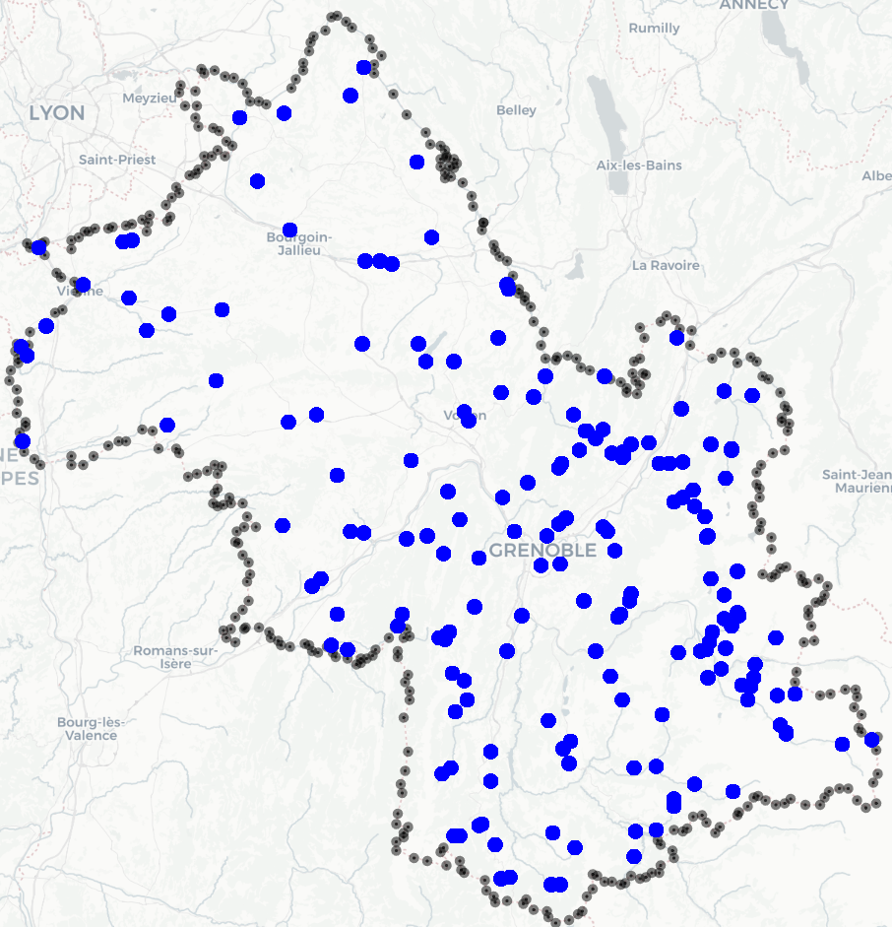


Cleaning
194 Stations, when cleaned, 58
1.860M entries from 1952 to 2022
main variable: Precipitation (rain)
co variables: altitude, longitude, latitude of the stations
Map with all the stations

